Slide 1
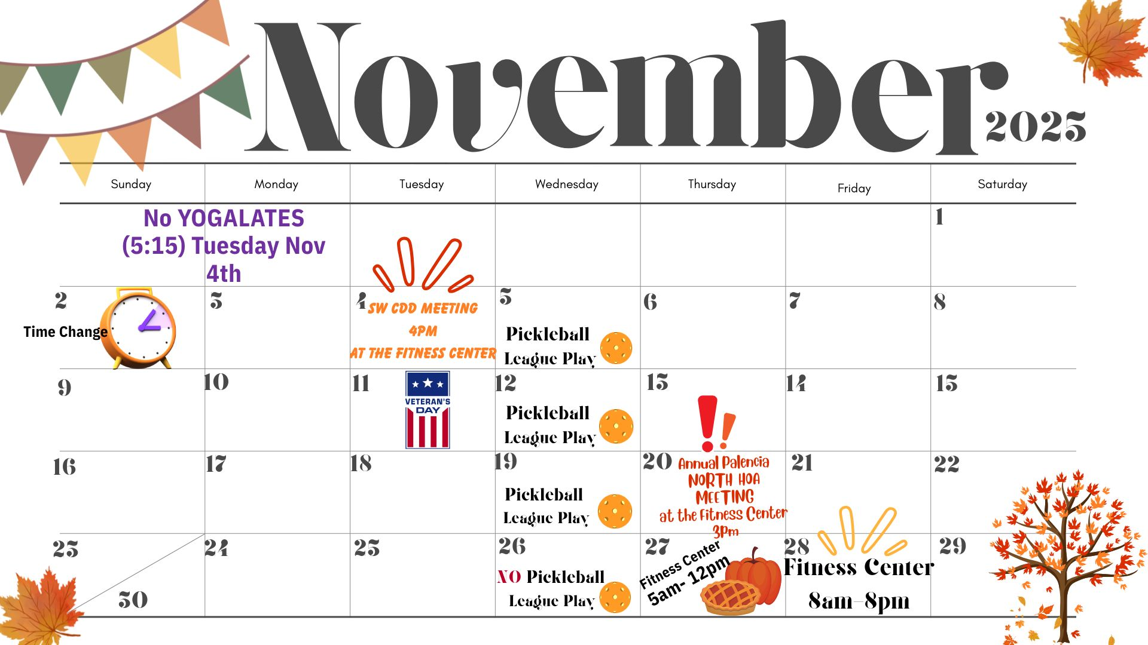

Slide 2


Slide 3
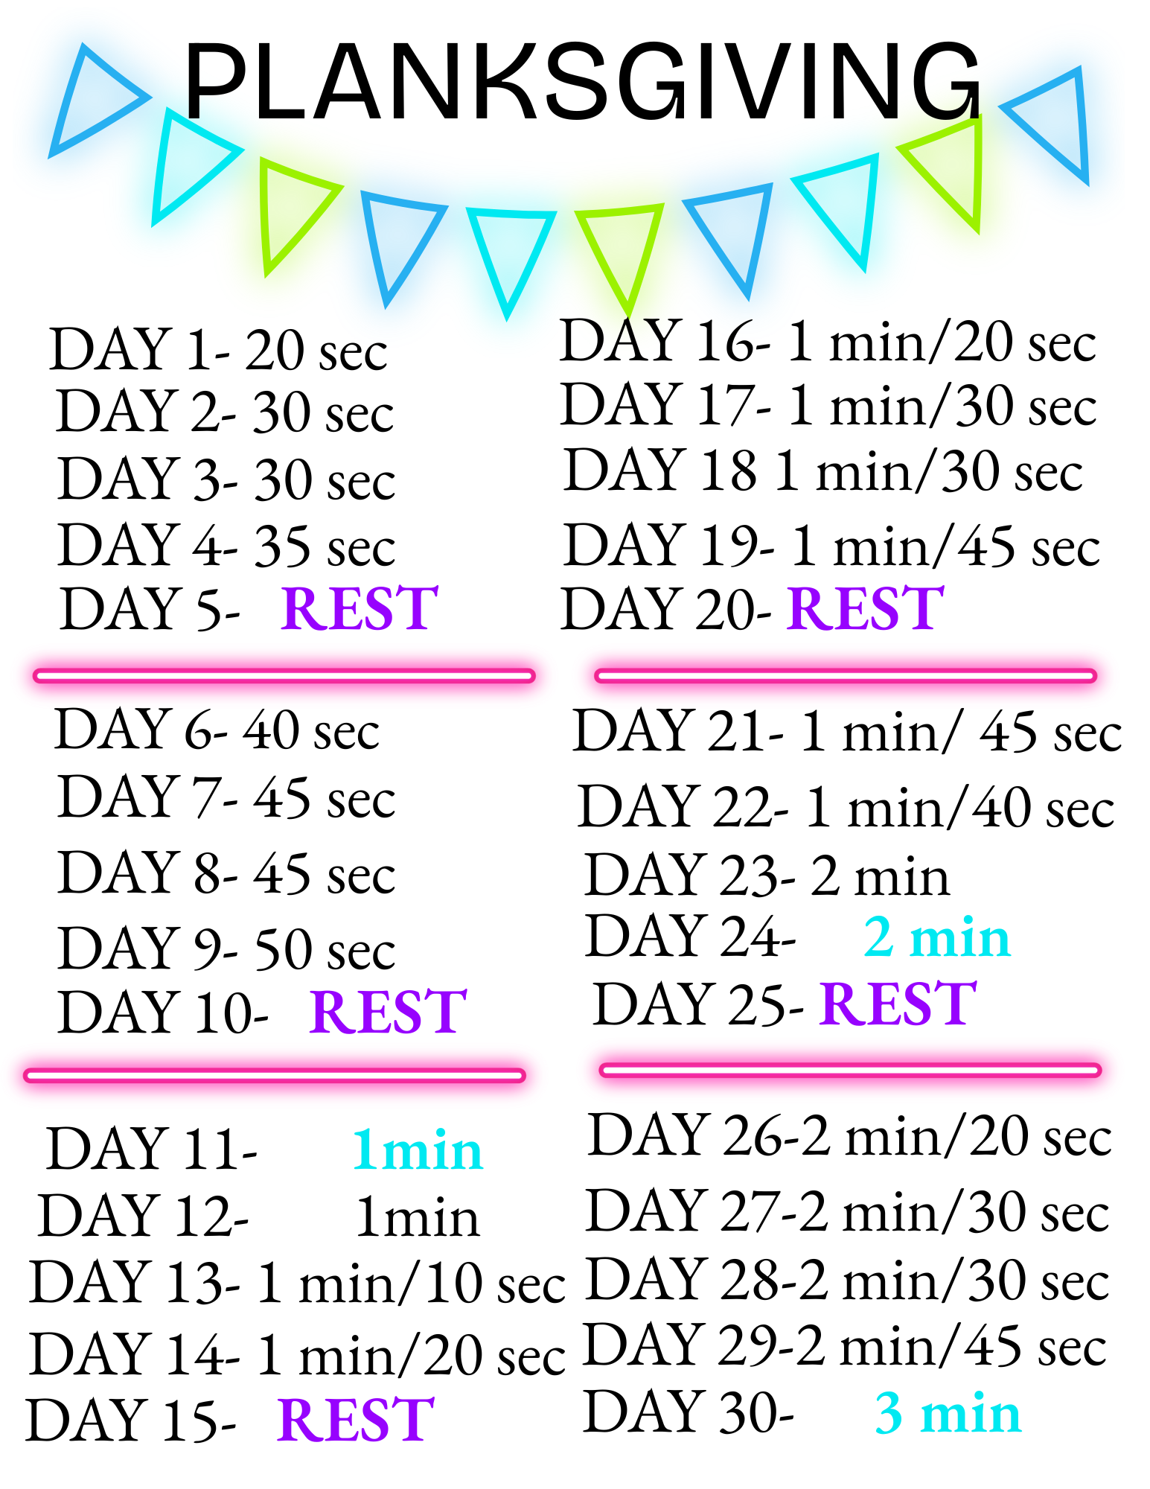
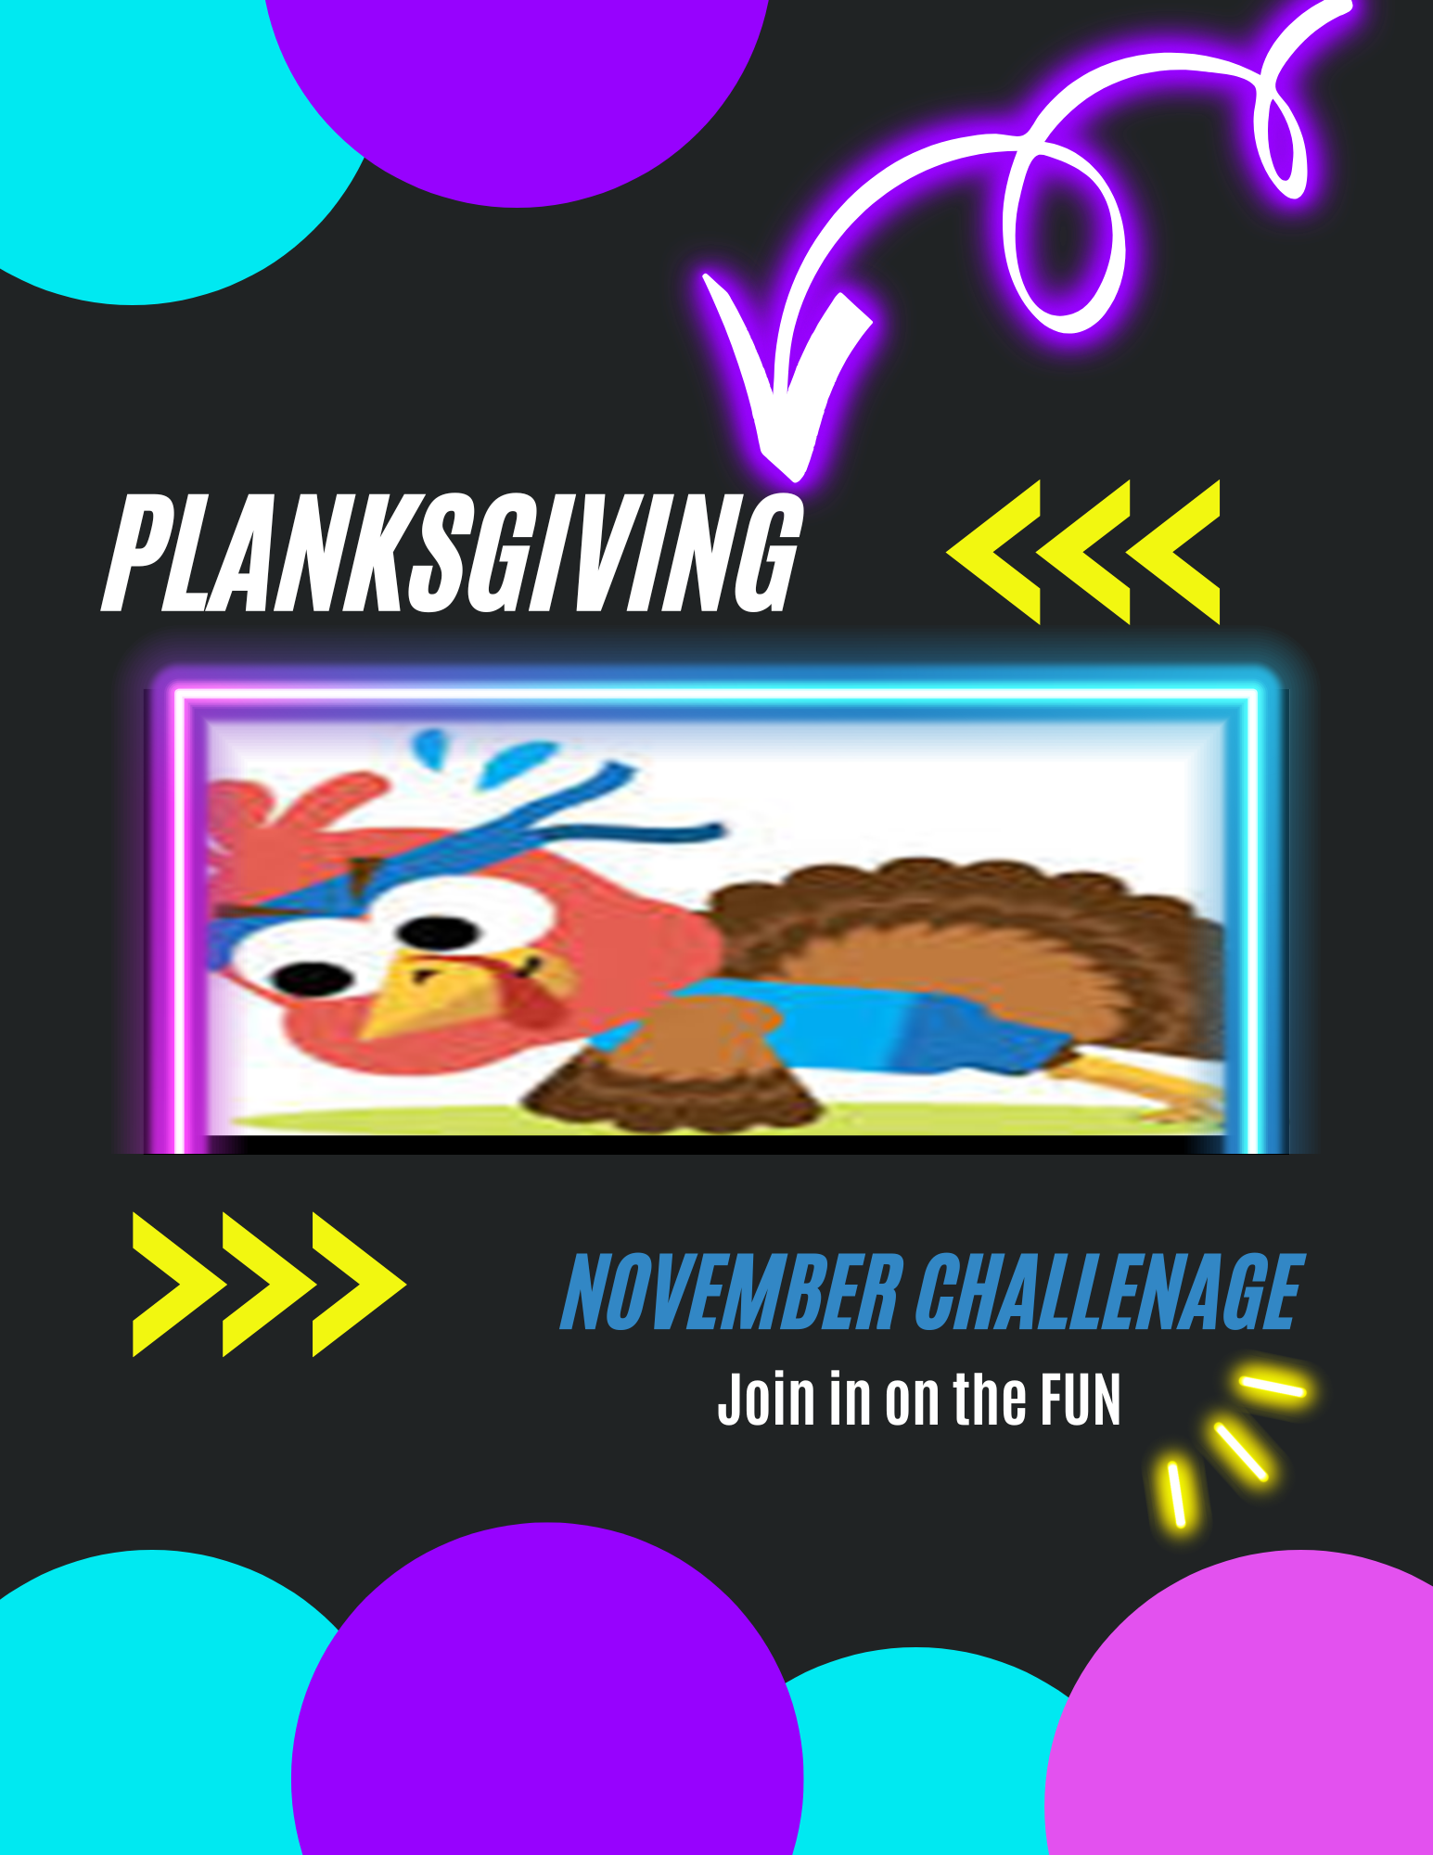

Slide 4

Mark your Calendar for this Class Cancellation

Slide 5

PALENCIA NORTH HOA Annual MEETING IS SCHEDULED FOR THURSDAY NOVEMBER 20th 3pm , AT THE FITNESS CENTER

Slide 6

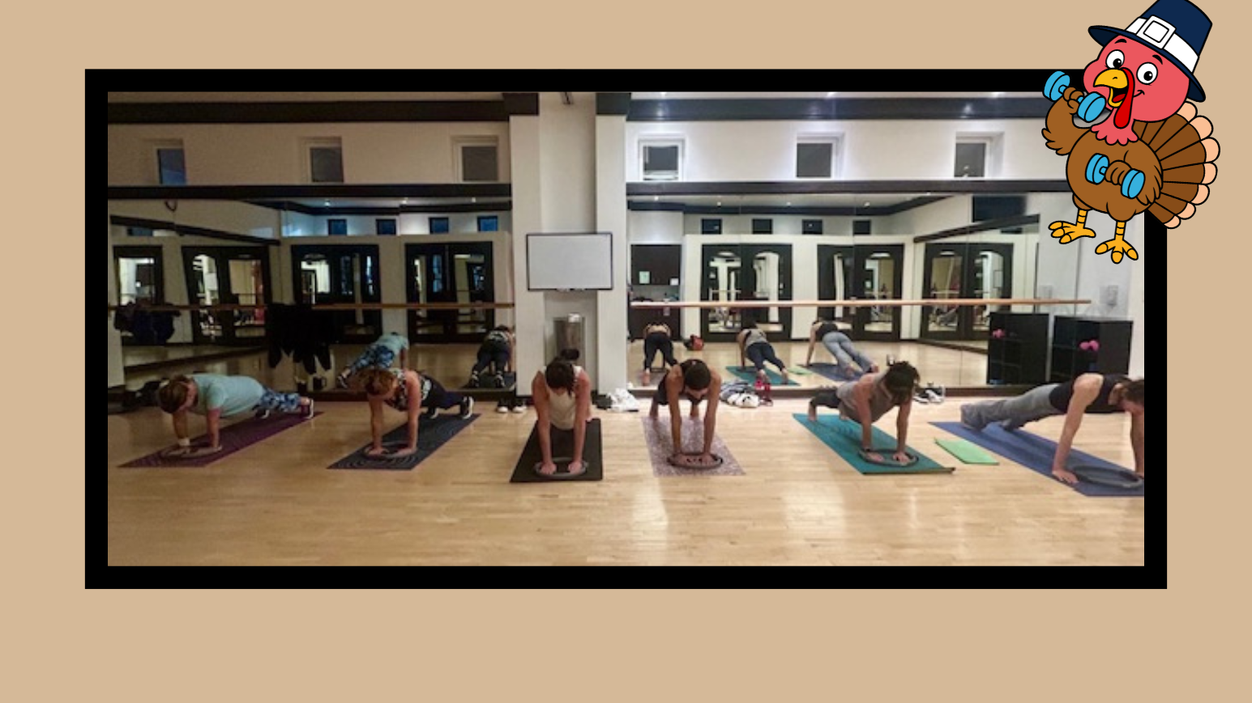
Planksgiving “Plank of the week”

Slide 7
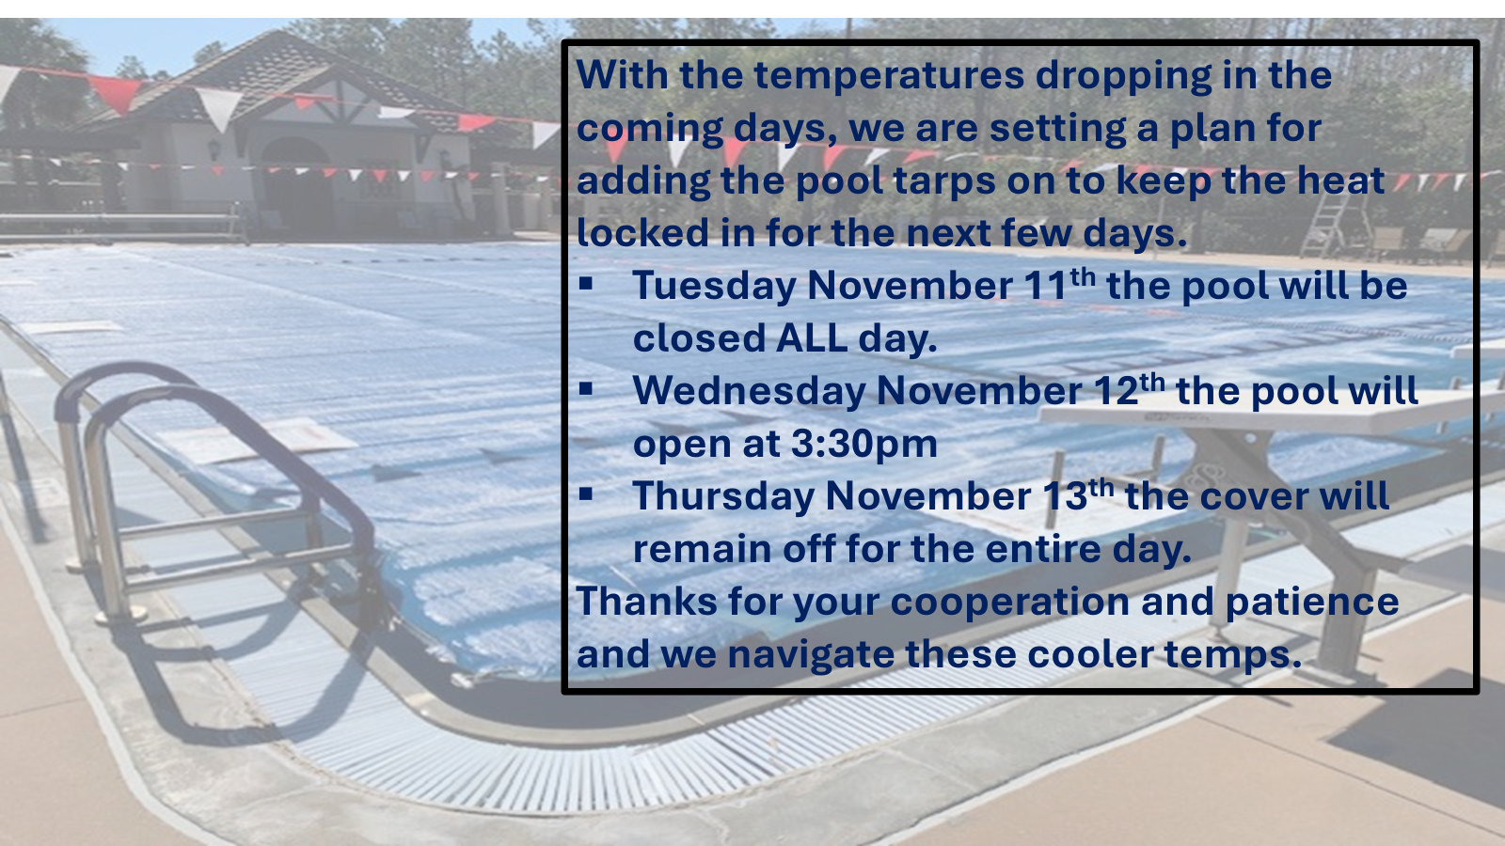

Slide 8
